Slide 1
Suicides in India: Based Upon gender & Ages
Project Presentation
Date: 21/08/2023
Presented by: Aayush Rehal & Suraj Mathas
Project Mentor: Mrs.Himani
Education & Training Division (ETD) Centre for Development of Advanced Computing (C-DAC) (Ministry of Electronics & Information Technology, Govt. of India) A-34, Phase-VIII, Industrial Area, Mohali (160071)

Slide 2
Table of Contents
Introduction
Problem statement
Objective or Problem formulation
Libraries Used
Design Methodology (Block Diagram or Work flow)
Dataset Explanation
Results – Front end clips, back end design clips, data base etc
Conclusion
References

Slide 3
Introduction
Examining the Alarming Suicides in India: Understanding the Causes, Impacts, and Potential Solutions

Slide 4
Introduction
Suicide rates in India have been on the rise, with Lakhs number of suicides reported in the year 2021 alone. This presentation aims to delve into the causes behind this alarming trend, explore its impacts on society, and propose potential solutions to address this critical issue.

Slide 5
Problem Statement
Multiple factors contribute to the high suicide rates in India, including socioeconomic pressures, mental health issues, lack of support systems, and cultural stigmas. Examining these causes is crucial to developing effective strategies for prevention and intervention

Slide 6
Objective or Problem Formulation
Examining the alarming suicides in India has highlighted the urgent need for action. By understanding the causes, impacts, and potential solutions, we can work towards creating a society that prioritizes mental health, provides support to those in need, and reduces the incidence of suicides. Together, we can make a difference.

Slide 7




Libraries Used
1.NumPy
2.Pandas
3.Matplotlib
4.Seaborn

Slide 8
Design Methodology
Problem Definition and Scope
Data Collection
Data Cleaning and Preprocessing
Exploratory Data Analysis (EDA)
Interpretation and Insights
Visualization and Reporting
Ethical Considerations
Feedback and Iteration

Slide 9
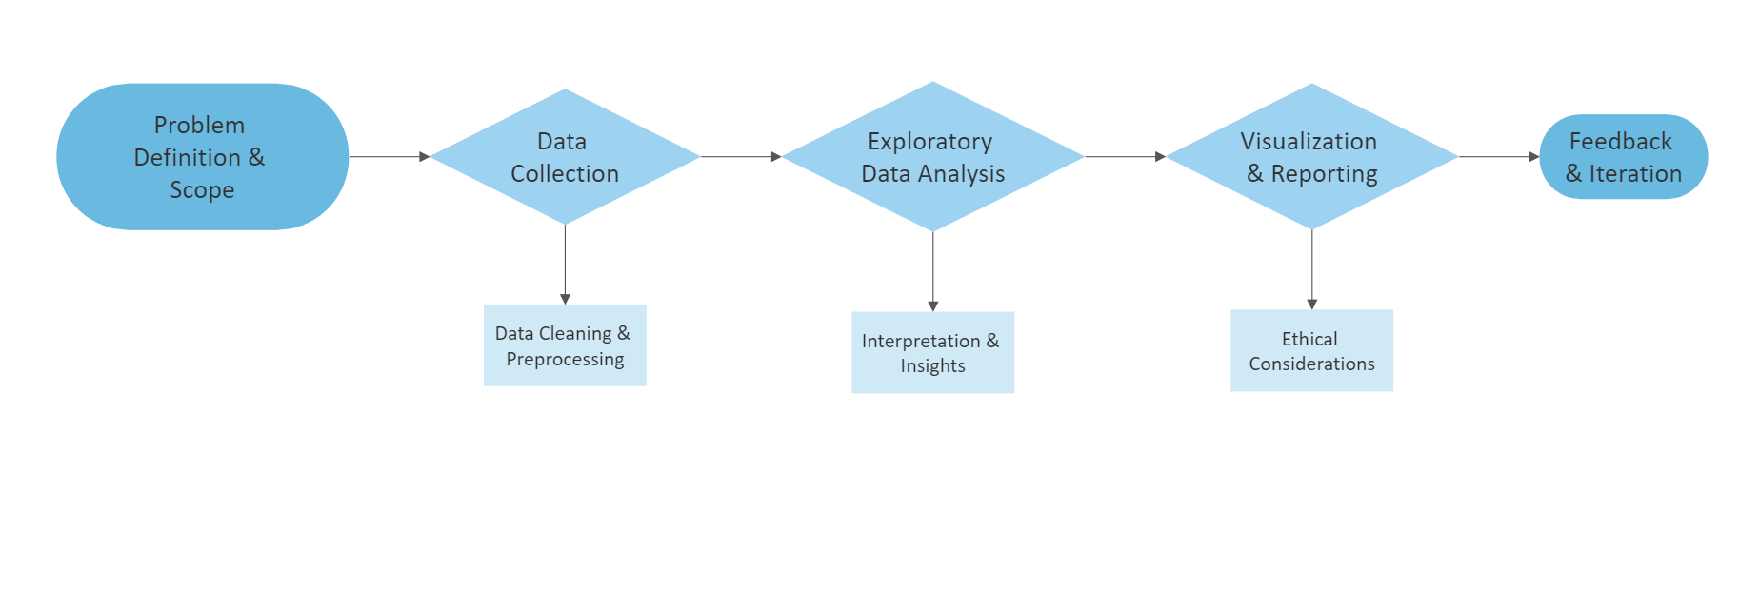
Design Flow Chart

Slide 10
DataSet Explanation
The 2021 suicide dataset reveals gender-based disparities and underlying causes. It indicates varying rates between genders, with males experiencing higher rates. Factors like Family Issues, Love Affairs, and Other challenges contribute. This dataset emphasizes the importance of targeted interventions and support systems for both genders, focusing on mental health awareness, economic stability, and relationship well-being to address the multifaceted reasons behind suicides in 2021.

Slide 11
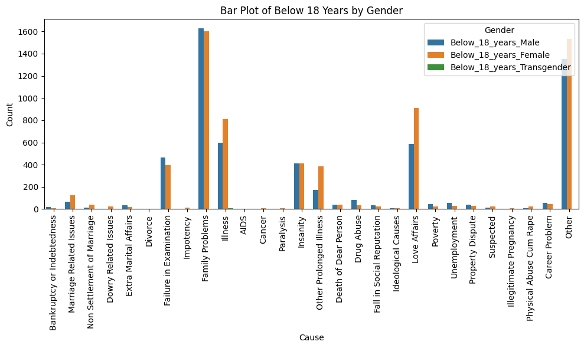
Results

Slide 12
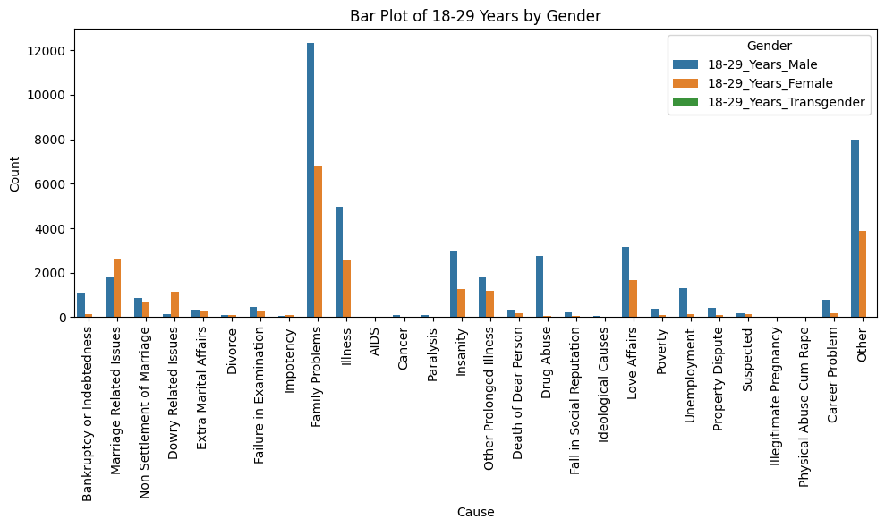
Results

Slide 13
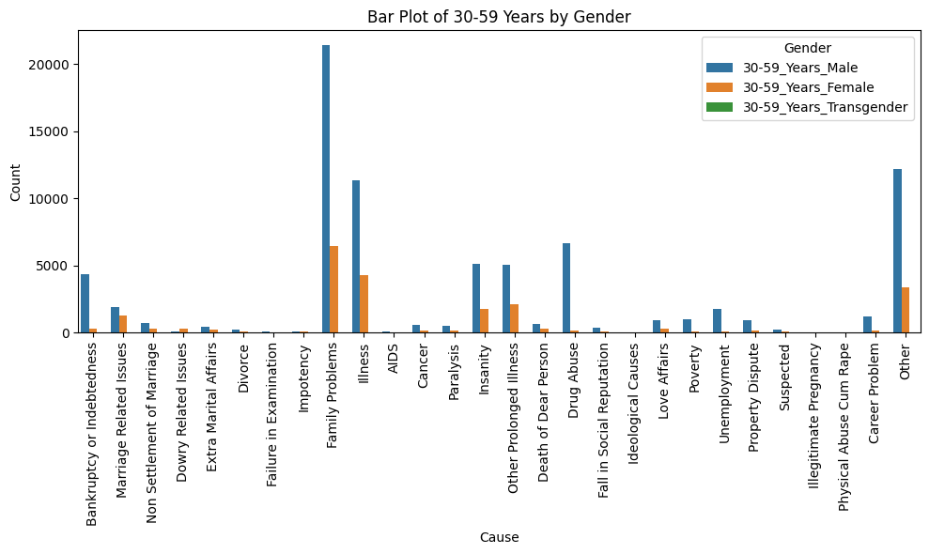
Results

Slide 14
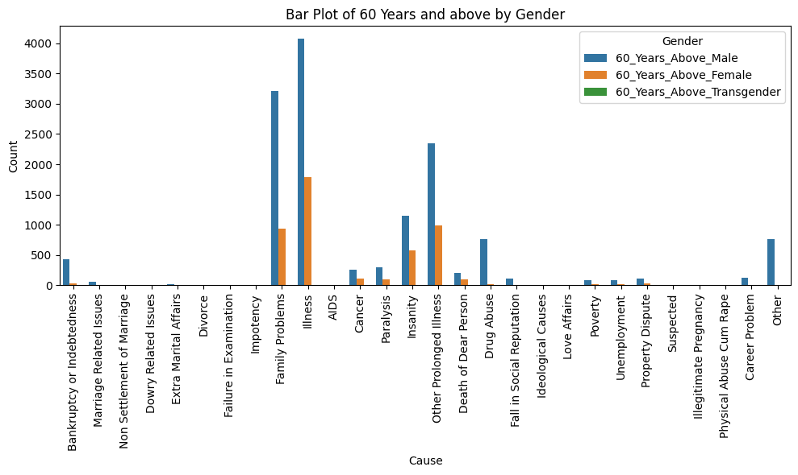
Results

Slide 15
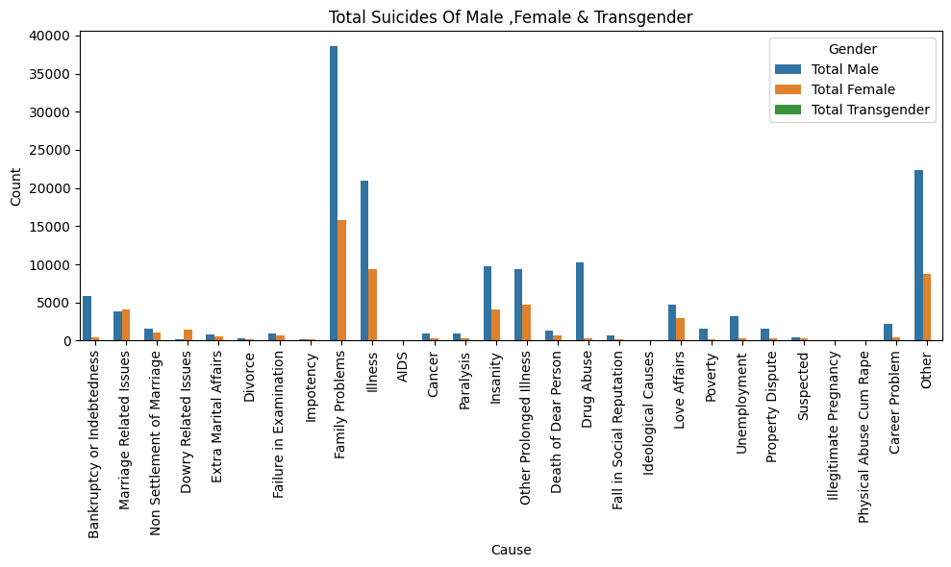
Results

Slide 16
Conclusion
In The Above Visulaization It Is Studied That Males Are Suiciding More Due To Family Problems Whereas Females Are Suiciding More Than Transgender
As We All Know Suicide Is A Biggest Cause Of Negativity In The Society It Spreads Very Fastly Among Childrens To Old Ones
According To My Research & Study It Is Recommended That Quaterly Basis Meetings Or Motivation Lecture Conducted On Village Level To Avoid Suicides
Youth Should Be Connected With Personal Mental Health Consultants Within Single Call

Slide 17
Conclusion
To prevent suicides, a comprehensive approach encompassing awareness, support, and intervention is crucial. First, promoting mental health awareness is essential, reducing stigma around seeking help. Communities should foster a supportive environment, encouraging open conversations about mental well-being. Accessible mental health services should be available, providing counseling and therapy.
Recognizing risk factors like isolation, substance abuse, and previous attempts is vital. Friends, family, and colleagues should be educated to identify signs and offer assistance. Crisis hotlines should be easily accessible and well-publicized. Schools and workplaces can implement mental health programs and stress management strategies.
Addressing socioeconomic issues through job stability, financial support, and reducing inequality can alleviate stressors. Additionally, media reporting guidelines on suicides should be followed to avoid triggering copycat incidents.
Ultimately, a compassionate society that prioritizes mental health, provides resources, and fosters human connections can significantly reduce the incidence of suicides.

Slide 18
References
As of my last knowledge update in September 2021, there are several reputable sources for collecting suicide dataset information in India. However, please note that these sources might have been updated or changed since then. Here are some reliable references you can consider:
1. National Crime Records Bureau (NCRB): The NCRB annually publishes "Accidental Deaths & Suicides in India" reports that provide detailed statistics on suicides in India, including demographic information and causes.
2. Research Journals and Publications: Peer-reviewed research journals in fields like psychiatry, psychology, and public health often publish studies on suicide rates and contributing factors in India.
3. Academic Institutions: Institutes conducting social science and mental health research might have datasets available for academic purposes.
4. Non-Governmental Organizations (NGOs):Some NGOs working in mental health might have compiled datasets or reports on suicide cases and prevention efforts.

